Slide 1



















Tahaluf Copyright 2022- All Right Reserved
Harmony IT Solution
learning Hub
Angular
Tahaluf Training Center 2022

Slide 2









Tahaluf Copyright 2022- All Right Reserved
Harmony IT Solution
1
Services in Angular.
2
Pipes.
3
RXJS Library.
4
5
6
7
8
8
9

Slide 3










Tahaluf Copyright 2022- All Right Reserved
Harmony IT Solution
Objective

Slide 4
Tahaluf Copyright 2022- All Right Reserved
Harmony IT Solution
The Objective of this lecture
Understand the concept of the service and how to generate a new service in the terminal.
How to use the pipe in the template in the angular project.
Understand the RXJS and the concept of observable methods.

Slide 5
Tahaluf Copyright 2022- All Right Reserved
Harmony IT Solution
Services in Angular

Slide 6
Tahaluf Copyright 2022- All Right Reserved
Harmony IT Solution
Overview of Services
Services are reusable pieces of code with a defined purpose. Your application will use this code across many components.

Slide 7
Tahaluf Copyright 2022- All Right Reserved
Harmony IT Solution
Overview of Services
Components need to access data. The data access code can be written in each component, but this is inefficient and violates the principle of single responsibility.
Rather, the component should focus on how to present data to the user.

Slide 8
Tahaluf Copyright 2022- All Right Reserved
Harmony IT Solution
Overview of Services
The process of getting data from the back-end server is delegated to another class, called the Service class.
This class provides data to every component that requires it.

Slide 9
Tahaluf Copyright 2022- All Right Reserved
Harmony IT Solution
The purpose of Angular Services
Is to provide features independent of components such as logging services.
Sharing logic or data among components.
Encapsulate interactions with external parties, such as data access.

Slide 10
Tahaluf Copyright 2022- All Right Reserved
Harmony IT Solution
Advantages of Angular Service
Tests are easier on services.
Debugging is easier.
The service can be reused in many places.

Slide 11
Tahaluf Copyright 2022- All Right Reserved
Harmony IT Solution
How to generate a new service
To create a service, use this command on the terminal:
ng generate service service_name or
ng g s service_name

Slide 12
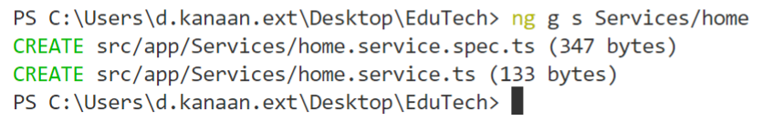

Tahaluf Copyright 2022- All Right Reserved
Harmony IT Solution
For example, to generate a new service
Generate a new service called home.
Here, the Services is a folder that will contain a home service.

Slide 13
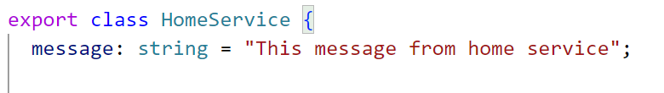
Tahaluf Copyright 2022- All Right Reserved
Harmony IT Solution
For example, to generate a new service
In the home service, define a new property and read the value of it in the home component.
In home.service.ts:

Slide 14
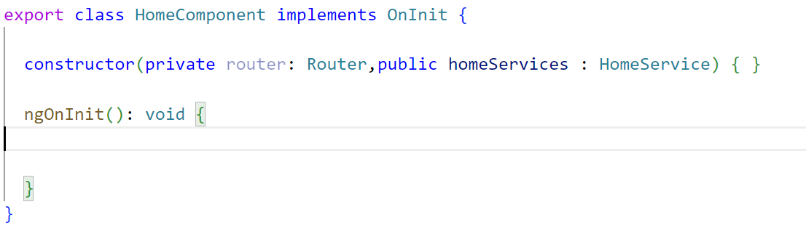
Tahaluf Copyright 2022- All Right Reserved
Harmony IT Solution
For example, to generate a new service
Define an object of home service in home.component.ts as a parameter of the constructor.

Slide 15
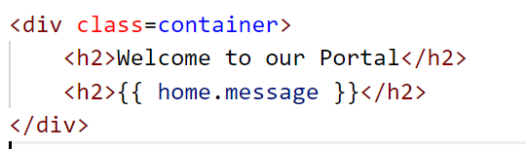
Tahaluf Copyright 2022- All Right Reserved
Harmony IT Solution
For example, to generate a new service
Read the value in home.component.ts.

Slide 16

Tahaluf Copyright 2022- All Right Reserved
Harmony IT Solution
Exercise:
Read the value of the message property from the login component and if the user logged successfully, update the message to “You are logged In ”.
Notes:
Exercise Solution:
In login.component.ts define an object of the service:
constructor(private spinner: NgxSpinnerService, private router: Router,
public homeservices: HomeService)
{
}
In login.component.html:
<h2>{{homeservices.message}}</h2>
Exercise Solution:
In login.component.ts, in submit function:
submit(){
//Go to Loader
this.spinner.show();
setTimeout(() => {
this.spinner.hide();
this.homeservices.message = "You are logged In"
//go to the home page
this.router.navigate(['client'])
}, 2000)
}

Slide 17

Tahaluf Copyright 2022- All Right Reserved
Harmony IT Solution
Services Example
Define an object in-home services called selected course, and if the user clicks on the image of the course, will navigate to the profile page and load the data for this course.

Slide 18
Tahaluf Copyright 2022- All Right Reserved
Harmony IT Solution
Services Example
Define an object of home service and router class service.

Slide 19
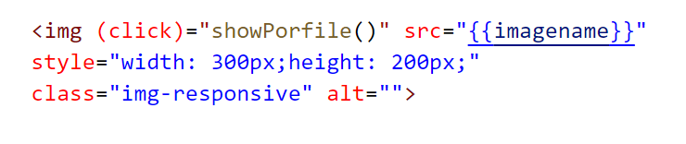
Tahaluf Copyright 2022- All Right Reserved
Harmony IT Solution
Services Example
In course-card.html add the output event of the image element.

Slide 20
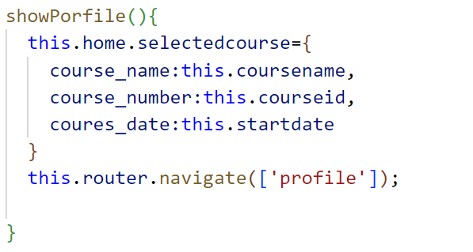
Tahaluf Copyright 2022- All Right Reserved
Harmony IT Solution
Services Example
Implement the show profile function in the typescript file for the course card component.
In course-card.ts

Slide 21

Tahaluf Copyright 2022- All Right Reserved
Harmony IT Solution
Services Example
Define an object of home service in profile.component.ts and use this object to bind the data in the profile component

Slide 22
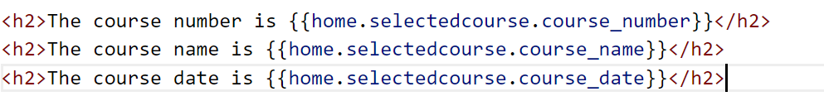
Tahaluf Copyright 2022- All Right Reserved
Harmony IT Solution
Services Example
In profile. component.html

Slide 23
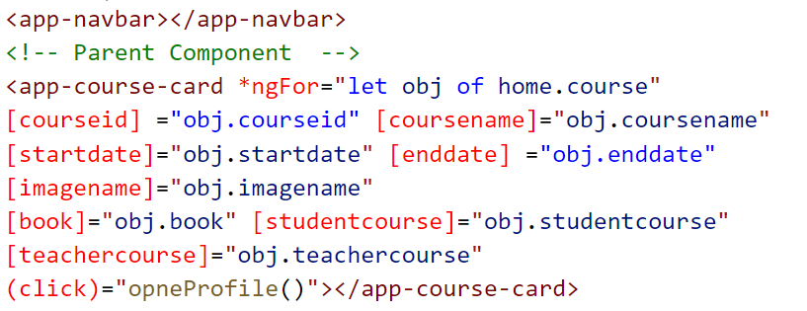
Tahaluf Copyright 2022- All Right Reserved
Harmony IT Solution
Services Example
The logic in the home component is the array. So, remove the array from the home component and rewrite it in-home service.
Update the home.component.html:

Slide 24
Tahaluf Copyright 2022- All Right Reserved
Harmony IT Solution
Services Example
Create a new service called auth. And remove the body of the submit function from login.ts and rewrite it in auth service.
NOTE: You can define services or package inside another service like NgSpinnerServices and Route package.

Slide 25
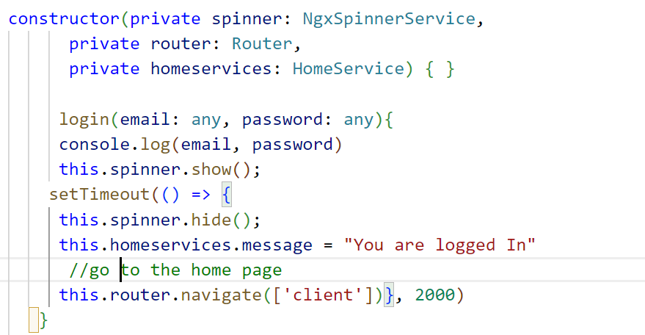
Tahaluf Copyright 2022- All Right Reserved
Harmony IT Solution
Services Example
In auth.service.ts

Slide 26
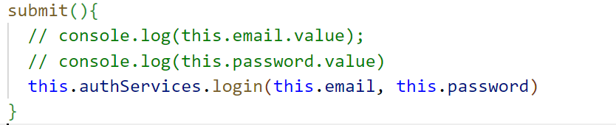
Tahaluf Copyright 2022- All Right Reserved
Harmony IT Solution
Services Example
Update the login component, so in login. component.ts

Slide 27
Tahaluf Copyright 2022- All Right Reserved
Harmony IT Solution
Pipes

Slide 28
Tahaluf Copyright 2022- All Right Reserved
Harmony IT Solution
Overview of Pipes
Angular has built-in pipes:
Date: returns a formatted date.
Uppercase: return upper case formatted.
Lowercase: returns lowercase formatted.
Percent: converts a value to a percentage.

Slide 29
Tahaluf Copyright 2022- All Right Reserved
Harmony IT Solution
Pipes Example
In homeService.ts:
{
course_name: 'HTML',
startdate: new Date(),
},
In course-card.component.html:

Slide 30
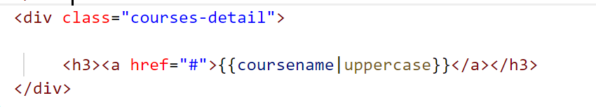
Tahaluf Copyright 2022- All Right Reserved
Harmony IT Solution
Pipes Example
In course-card.component.html:

Slide 31
Tahaluf Copyright 2022- All Right Reserved
Harmony IT Solution
RxJS

Slide 32

Tahaluf Copyright 2022- All Right Reserved
Harmony IT Solution
Overview of RxJS:
Reactive extensions for JavaScript are called RxJS.
This JavaScript library uses observables to handle asynchronous calls, callbacks, and event-based programming using reactive programming.

Slide 33
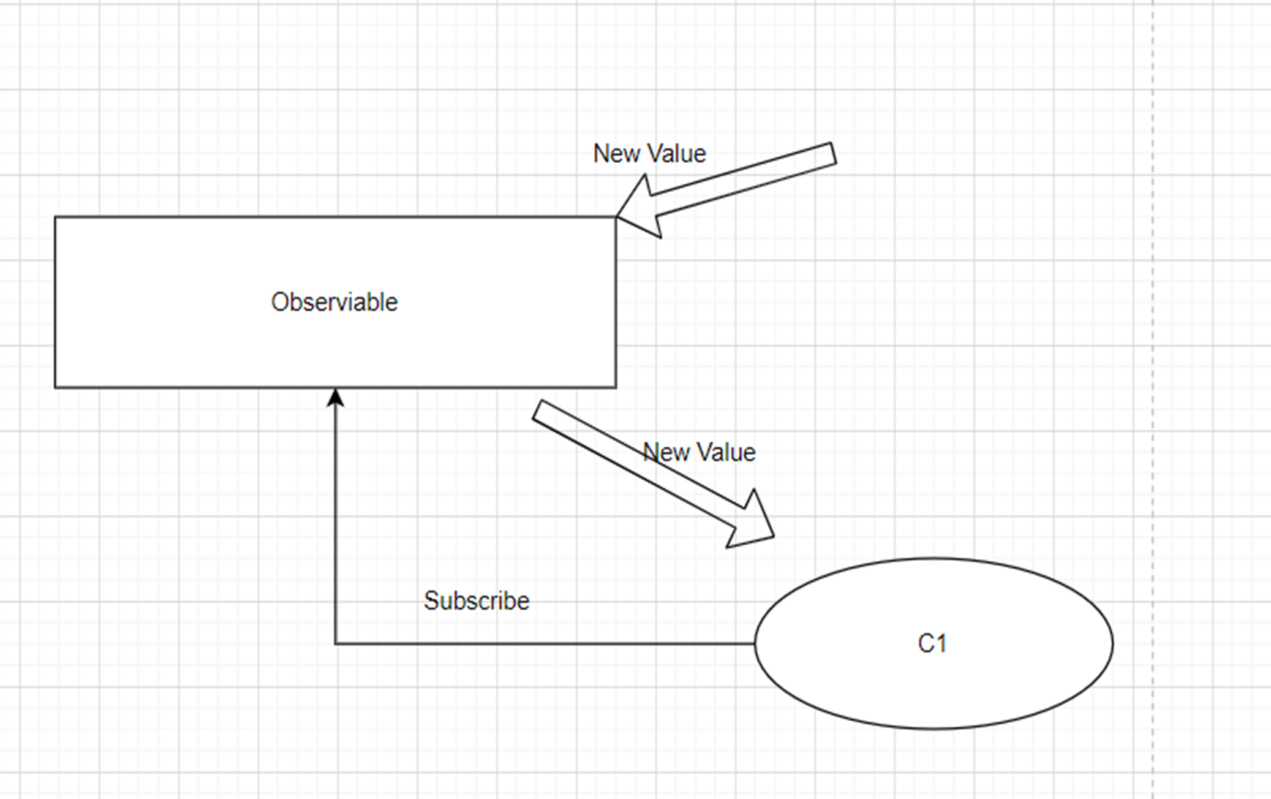
Tahaluf Copyright 2022- All Right Reserved
Harmony IT Solution
Overview of Observable:
.

Slide 34
Tahaluf Copyright 2022- All Right Reserved
Harmony IT Solution
RxJS Example:
In HomeServices, declare an object of behavior subject and give the default value = 0.
This object is like a counter for how many courses are in the system.
Notes:
numberOfActiveCourse = new BehaviorSubject(0);

Slide 35
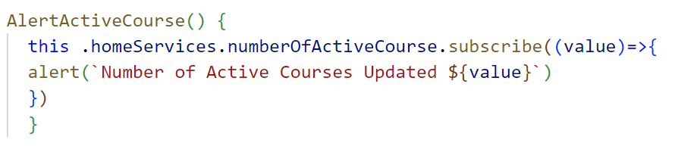
Tahaluf Copyright 2022- All Right Reserved
Harmony IT Solution
RxJS Example:
Create a function in home.component.ts to subscribe to the object of the behavior subject.
Notes:
AlertActiveCourse() {
this .homeServices.numberOfActiveCourse.subscribe((value)=>{
alert(`Number of Active Courses Updated ${value}`)
})
}

Slide 36
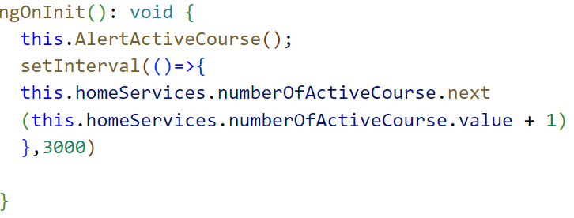
Tahaluf Copyright 2022- All Right Reserved
Harmony IT Solution
RxJS Example:
Inside OnInit function in home.component.ts:
Notes:
ngOnInit(): void {
this.AlertActiveCourse();
setInterval(()=>{
this.homeServices.numberOfActiveCourse.next
(this.homeServices.numberOfActiveCourse.value + 1)
},3000)
}

Slide 37
Tahaluf Copyright 2022- All Right Reserved
Harmony IT Solution
Exercise:
Add another variable in home.component.ts and make the value for this variable equal to the value for the number of active courses and display it on the home component and In profile component.
Notes:
In home.component.ts:
CurrentActiveCourse:number =0;
AlertActiveCourse() {
this .homeServices.numberOfActiveCourse.subscribe((value)=>{
//alert('the new value is '+value);
this.CurrentActiveCourse=value;
})
}
In home.component.ts:
CurrentActiveCourse:number =0;
AlertActiveCourse() {
this .homeServices.numberOfActiveCourse.subscribe((value)=>{
//alert('the new value is '+value);
this.CurrentActiveCourse=value;
})
}
In profile.component.ts
currentCourse:number=0;
ngOnInit(): void {
this .home.numberOfActiveCourse.subscribe(value=>{
this.currentCourse=value;
})
}
In profile.component.html
<h1>Current Active Course {{currentCourse}}</h1>
<h2>{{home.selctorCours.description}}</h2>
<h2>{{home.selctorCours.subTitle}}</h2>
<h2>{{home.selctorCours.type}}</h2>

Slide 38
Tahaluf Copyright 2022- All Right Reserved
Harmony IT Solution
References
[1] Angular, “Angular,” Angular.io, 2019. https://angular.io/
[2] “Complete Angular Tutorial For Beginners,” TekTutorialsHub. https://www.tektutorialshub.com/angular-tutorial/
[3]“npm | build amazing things,” Npmjs.com, 2019. https://www.npmjs.com/
[4]“Angular Tutorial for Beginners | Simplilearn,” Simplilearn.com. https://www.simplilearn.com/tutorials/angular-tutorial (accessed Aug. 19, 2022).
Overview of Database

Slide 39








Tahaluf Copyright 2022- All Right Reserved
Harmony IT Solution
Thank youﻂﺤﻧ
Any Question?

